Slide 1

Excel
4370_Pravallika

Slide 2
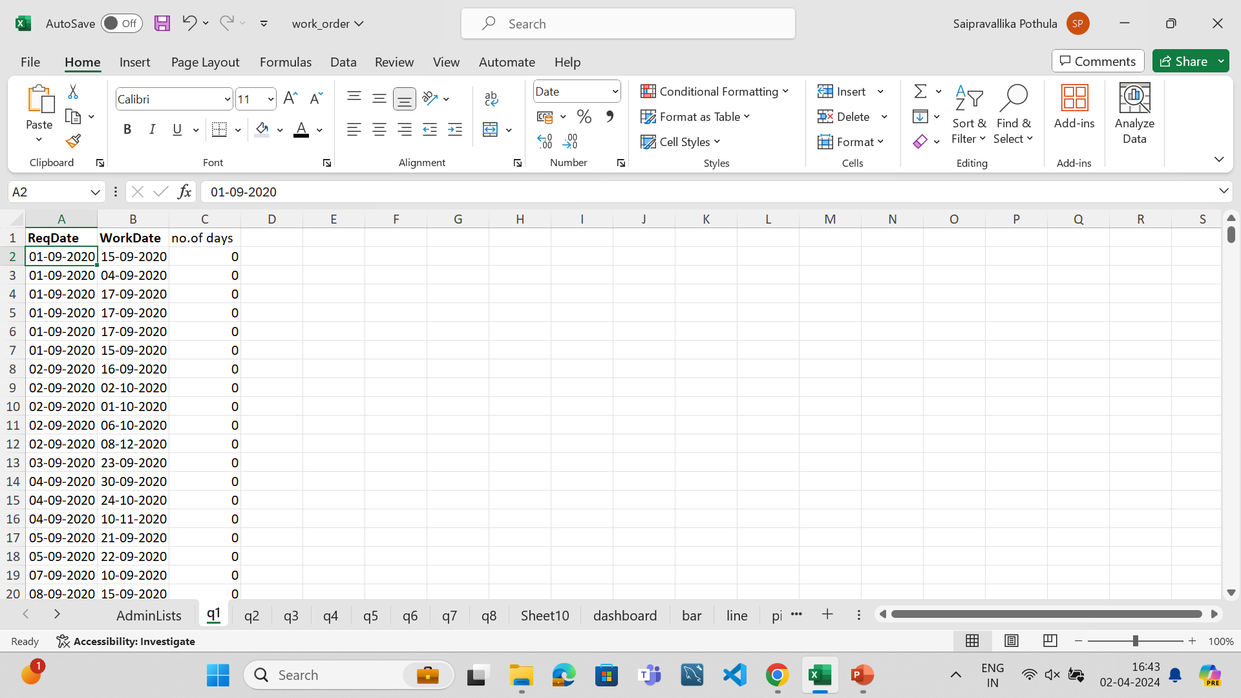
Question 1
The average time lead between the req date and submitted date can be calculated by count..

Slide 3
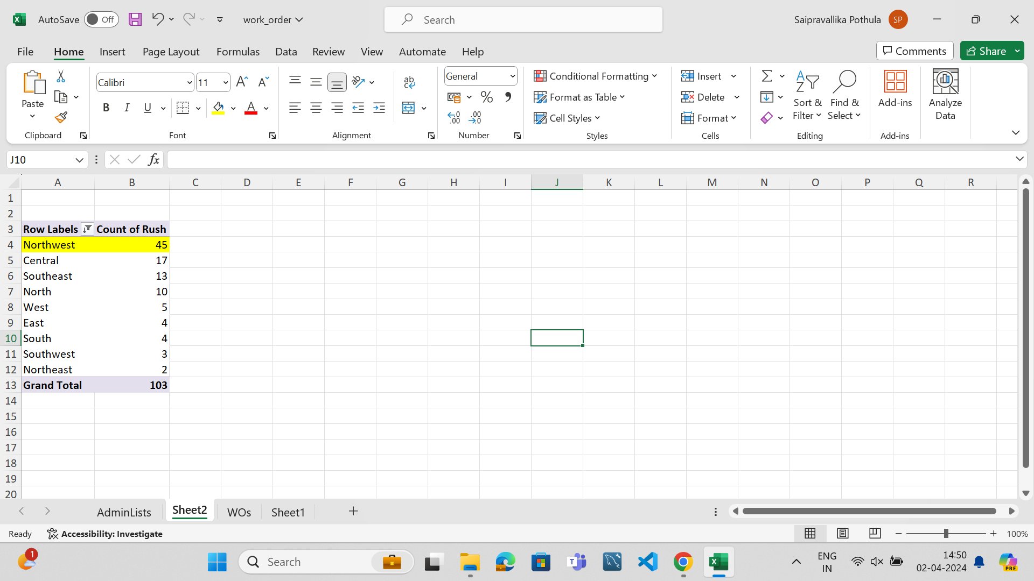
Question 2
The Northwest District has the highest number of rush jobs.
Here pivot table is sorted according the districts with highest number of rush jobs.
In the pivotable fields, Districts are taken as rows and count of rush jobs as values.

Slide 4
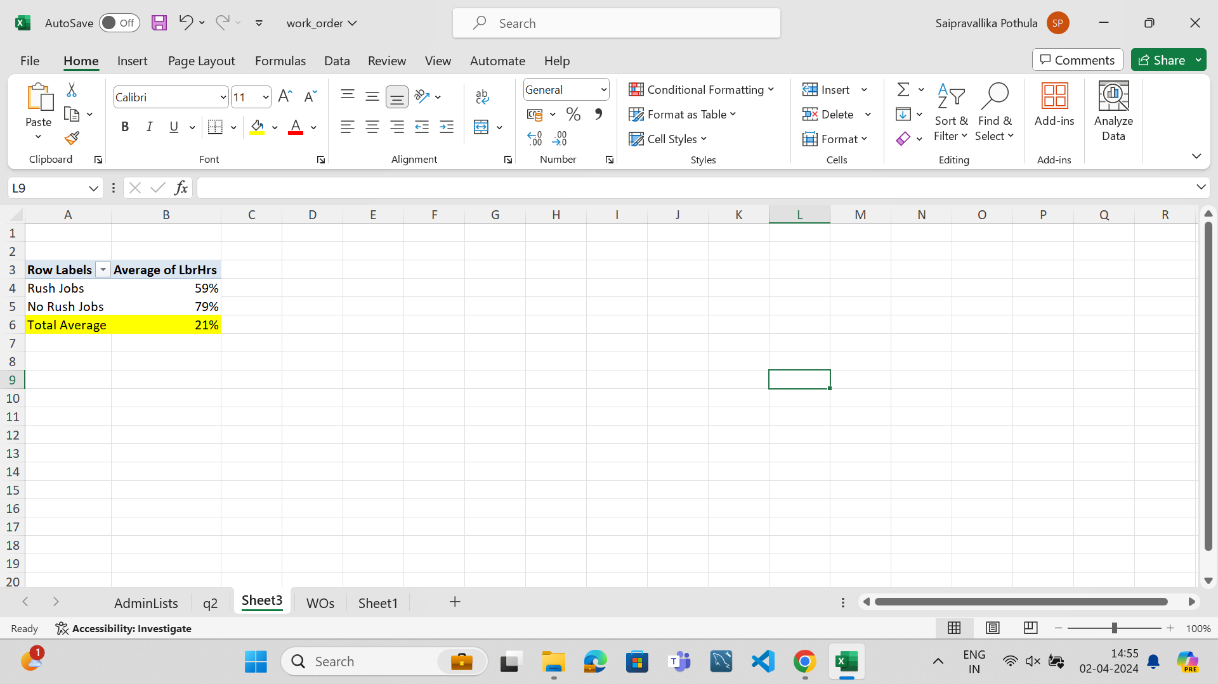
Question 3
The Average labor hours differ between rush and no rush jobs with 21%.
In the pivotable fields, rush are taken as rows and average of lbr hrs as values.
Formula:
=GETPIVOTDATA("LbrHrs",$A$3,"Rush",)-GETPIVOTDATA("LbrHrs",$A$3,"Rush","Yes")

Slide 5
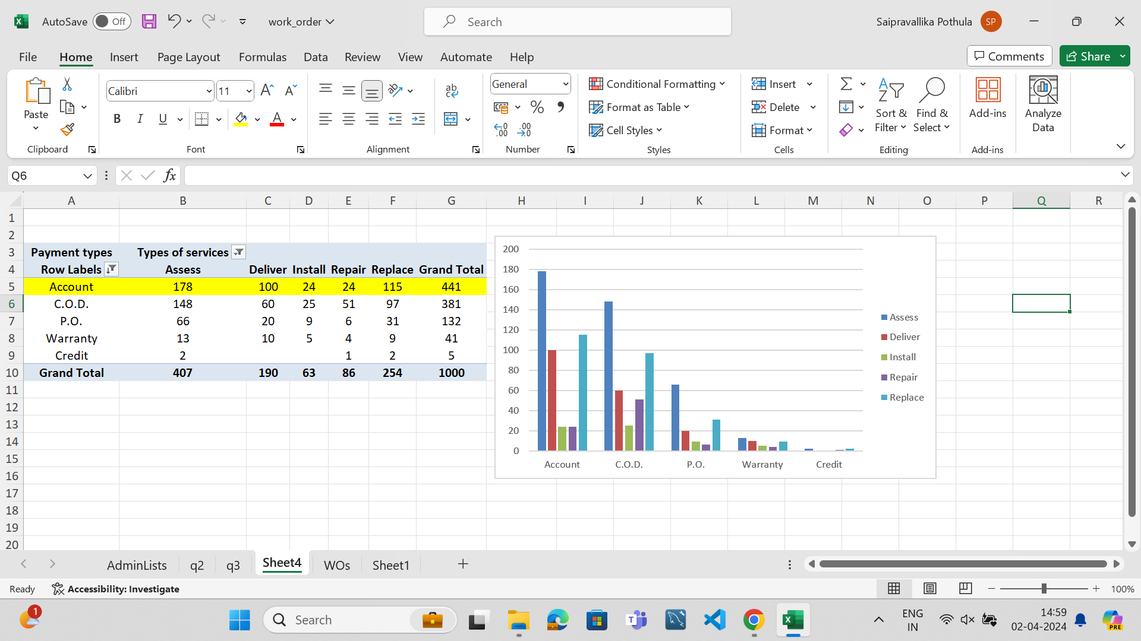
Question 4
The distrubution of payment types is highest in account
In the pivotable fields, payments are taken as rows and payment types values, service as columns.

Slide 6
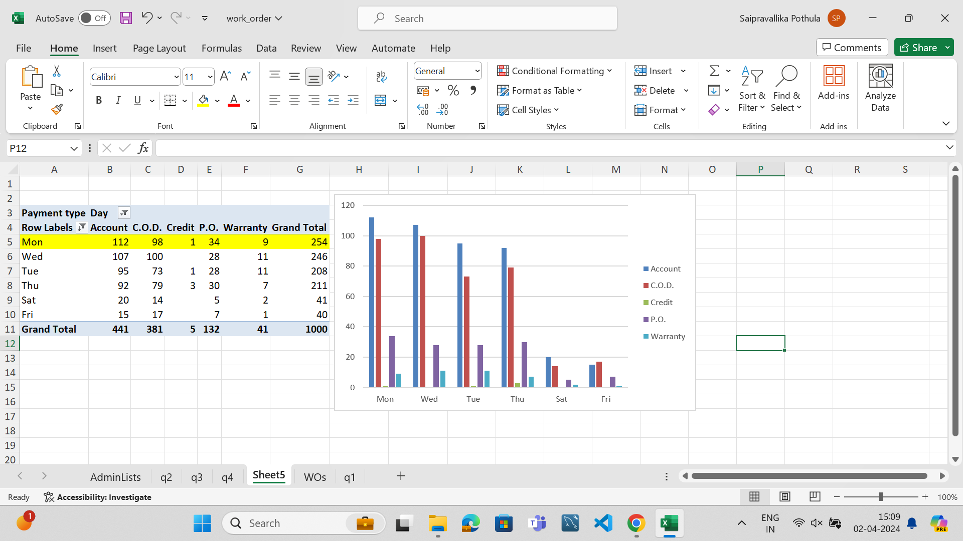
Question 5
The distrubution of payment types over time is recorded highest on Monday.
In the pivotable fields, ReqDay are taken as rows and payment types values, Payments as columns.

Slide 7
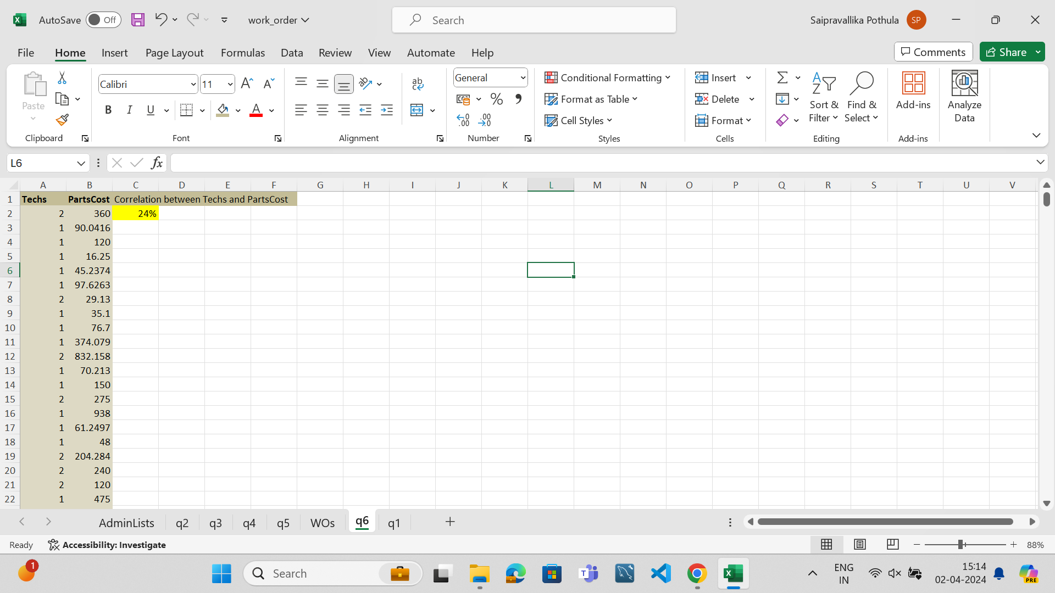
Question 6
The correlation between number of technicians and Parts costs is 24%.
Formula:
=CORREL(B:B,A:A)

Slide 8
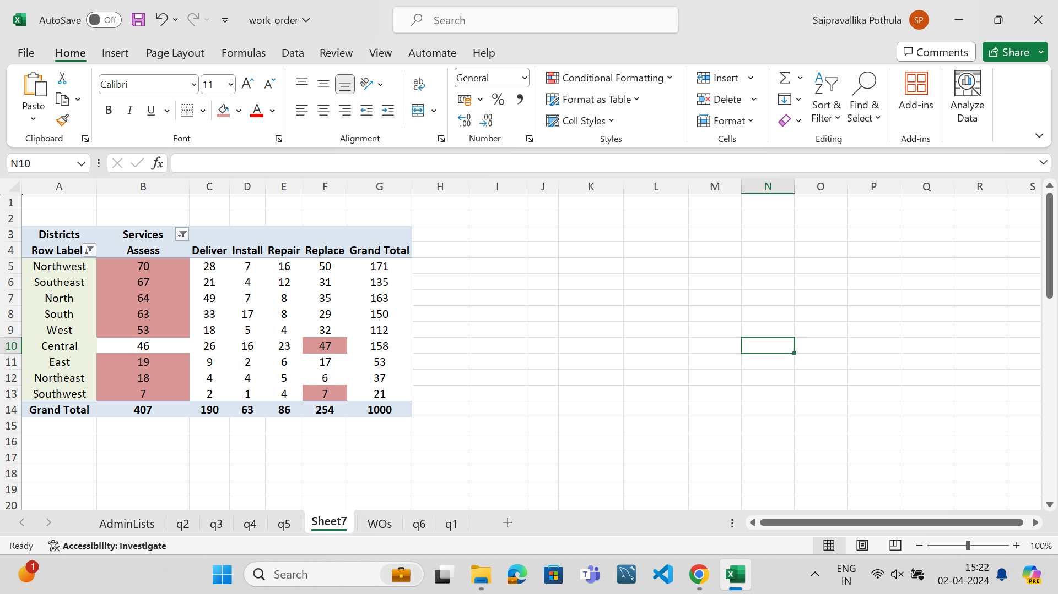
Question 7
The most common type of service requested in each district is varied. Assess service type is most used in Northwest, Southeast, North, South, West, East, Northeast, Southwest.
Where as, Replace service type is most used in Central district.
In the pivotable fields, Districts are taken as rows and values, Service as columns.

Slide 9
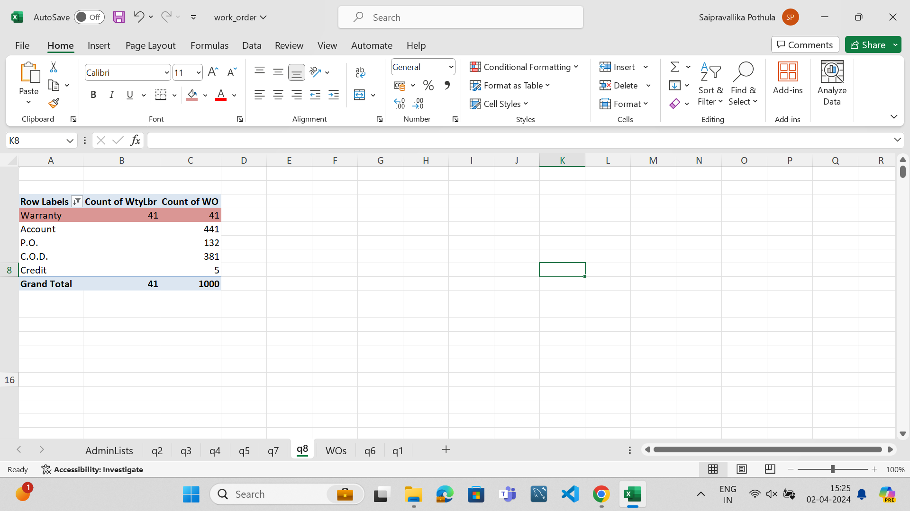
Question 8
The diff between the distribution is clearly shown with 41.
In the pivotable fields, payments are taken as rows, Count of Wty Lbr and values, Values as columns.

Slide 10
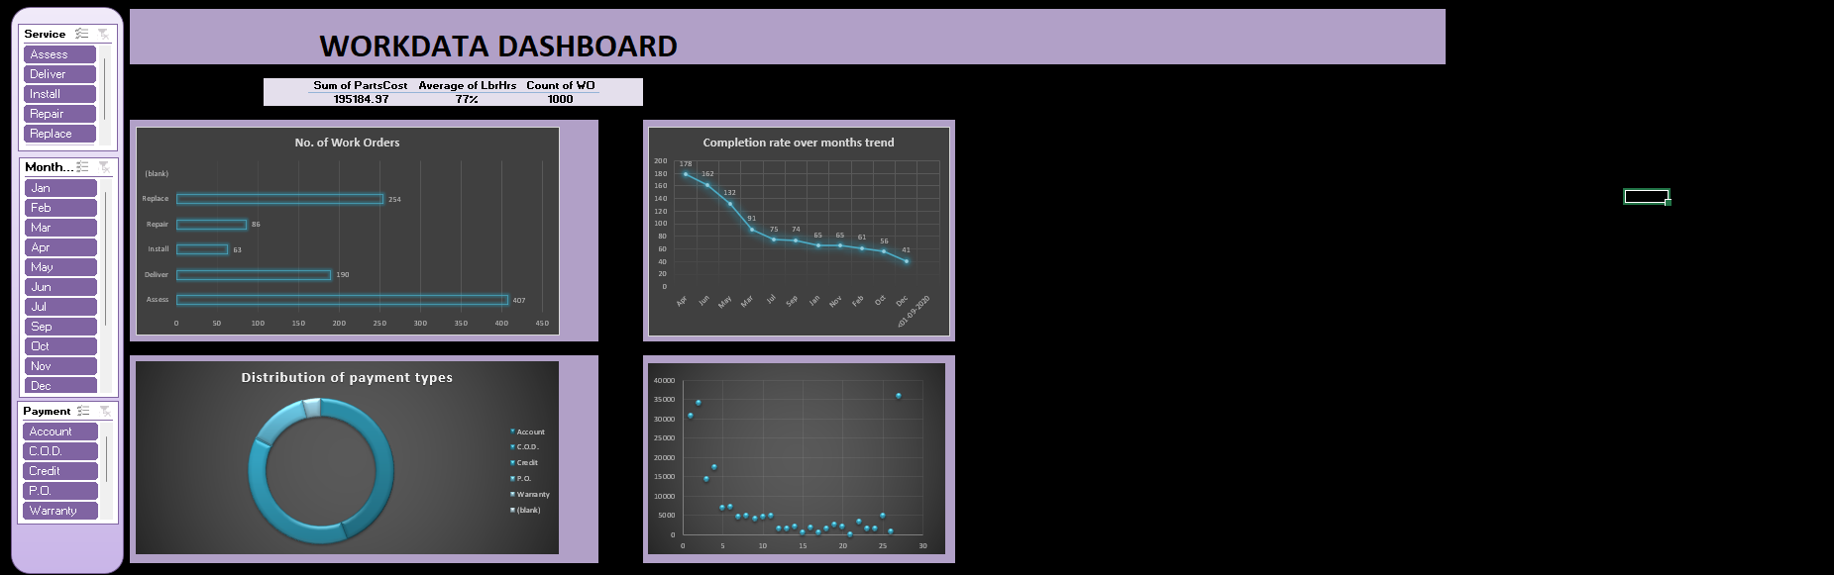
Question 9

